Slide 1
Dating Techniques

Slide 2

Objectives
In this Smart Lesson you will learn about relative and absolute dating techniques, and how they are used to locate fossils onto the geological time scale.

Slide 3
There are two methods of fossil dating:
• absolute dating
and
• relative dating

Slide 4
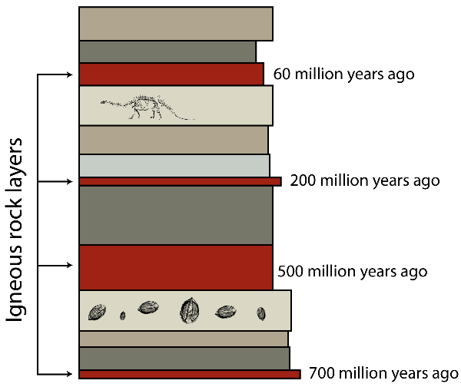
Absolute dating is the process of determining how old the rock is by looking at the radioactive material in the rocks and how it has decayed.
Relative dating is the term used to describe how we know that deeper layers are older and layers closer to the surface are younger.

Slide 5


Slide 6
Sequencing a fossil record requires a combination of relative and absolute dating techniques to locate fossils onto the geological timescale.
In the next section you will start to look at some techniques:
 | Relative Dating Techniques:
• | Index Fossils
• | Stratigraphy
 | Absolute Dating Techniques:
• | Radiocarbon dating
• | Potassium-argon dating

Slide 7
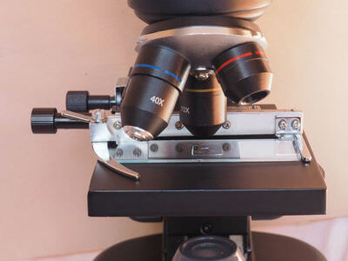
Index Fossils
Index fossils are fossils which are useful for dating and correlating the strata (rock layer) in which they are found. Microfossils are particularly good for investigating geological time. These are prehistoric remains that are very small, so you need a magnifying glass or a microscope to even see them.
Very small fossils are easy to collect and identify, assuming you know where to look. They're used to compare the ages of rock formations in different parts of the world.

Slide 8
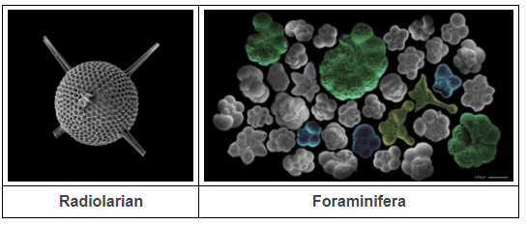
Two particular types of microfossils are abundant in the fossil record. Try and pronounce the names of these groups - radiolaria and foraminifera.
Radiolaria are single-celled critters that live in tiny shells made of silica, the same stuff glass is made from. Foraminifera are also single-celled, but their shells are carbonate-based, more like chalk than glass.

Slide 9
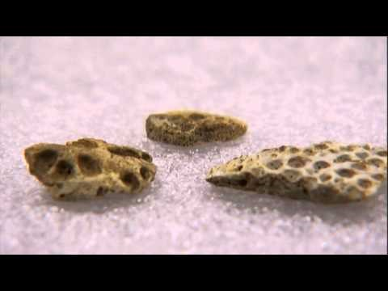

Slide 10

Stratigraphy
Fossils, whether big or small, can be used for correlation. This is the skill of matching rock layers, or strata, of similar age. Older rocks form first, so are found at lower levels, whilst newer rocks are closer to the surface. Stratigraphy correlates the layers with the geological timescale.
The strata may be in completely different parts of the world and made of different rocks, but if they contain the same fossils, chances are they were formed at the same time.
The layers in sedimentary rocks are an example of strata.

Slide 11
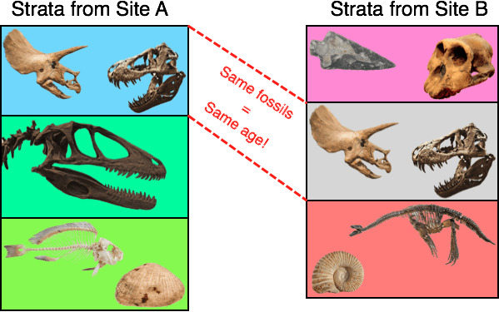
Here is an example of correlation.
The left column shows strata from a quarry. The right column shows strata from a different quarry in a different country. As you can see, the rocks they're made of are very different, but one layer in each column contains the exact same fossils. That means these layers were formed at the same time!

Slide 12
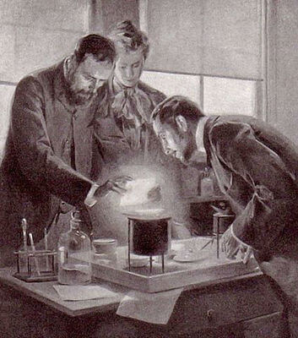
Absolute Dating
It wasn't until last century that scientists finally found a way to accurately measure the age of a rock.
It started with the discovery of radioactivity by Henri Becquerel and Marie Curie.

Slide 13
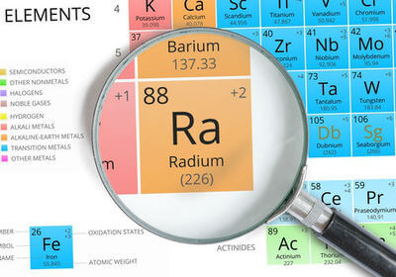
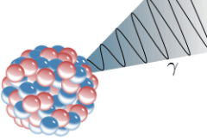
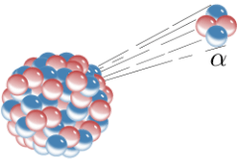
Varieties of some chemical elements, called isotopes, give off natural radiation in the form of alpha particles, beta particles and gamma rays. Strongly radioactive elements include radium and polonium, both of which were discovered by Marie Curie.

Slide 14

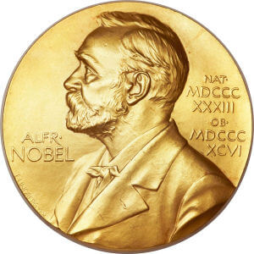
Radioactive isotopes are found all over the place - you can't get away from them. There is even radiation being emitted inside your body right now!
This discovery led Willard Libby to develop a method called radiometric dating in the years after World War II. He looked for a radioactive isotope of carbon in dead tissue, then used it to calculate the time since death. Like Curie and Becquerel before him, Libby won a Nobel Prize for his work.

Slide 15
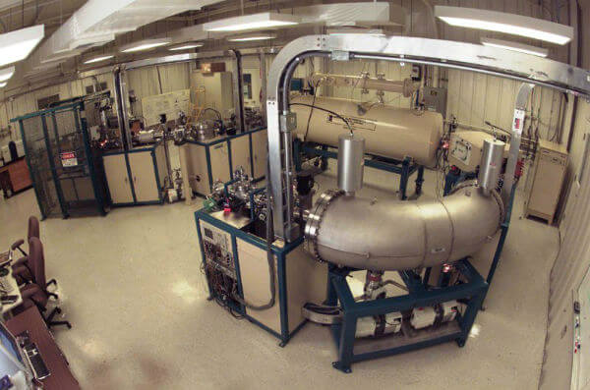
Massive machines like this accelerator mass spectrometer are now used in radiometric dating. They rely on the fact that radioactive isotopes "decay" into different elements as they emit radiation. They always decay at a certain rate.

Slide 16
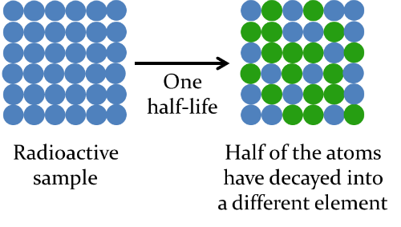
The rate of decay of an isotope is called its half-life.
One half-life is the time taken for half the radioactive atoms in a rock sample to decay into a different element. It is a constant rate for any given isotope.

Slide 17

Carbon-14 is the isotope that Libby studied, but it decays relatively quickly, with a half-life of 5730 years.
Geologists suspected that many rocks were millions of years old, so to get more accurate measurements, they looked for isotopes with longer half-lives. They include varieties of uranium, thorium, potassium and zirconium.

Slide 18

How does radiometric dating actually work? It’s quite complicated and maths, but here’s what it comes down to:
If you know the half-life of an isotope, how much of that isotope is left in a rock, how much of the main decay product there is, and you have an idea of how many isotopes were in the rock to begin with, you can calculate the age of the rock. Awesome!

Slide 19
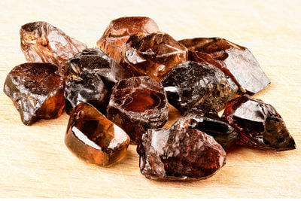
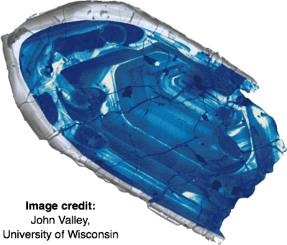
There is always some amount of error in the calculations. For instance, the oldest crystal ever found has an age of 4.4 billion years, give or take 6 million years (the error).
That may sound like a lot, but compared to 4.4 billion, 6 million is a relatively small number. It’s less than 0.14% of the calculated age - a very small percentage error indeed! Geologists can be pretty confident about the numbers they get.

Slide 20
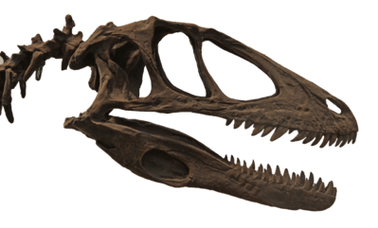
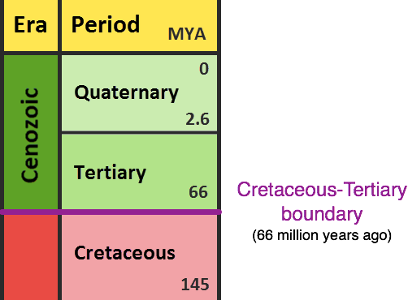
Let's peek at the geological timescale. With radiometric dating, it was finally possible to put precise dates on each of the boundaries between time periods.
For instance, an iridium-rich rock formation provided the date of 66 million years ago for the end of the Cretaceous Period. This marks the extinction of the dinosaurs!

Slide 21
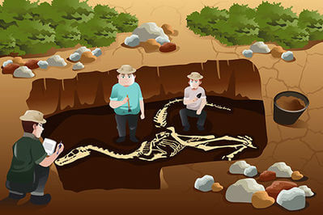
Scientists can use naturally occurring radioisotopes to determine the age of artefacts, fossils and rocks. This is called radiometric dating.
When scientists use this method with carbon isotopes, it is called radiocarbon dating (or just carbon dating).

Slide 22


Slide 23
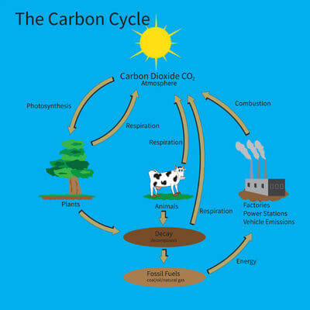
All living things contain carbon!
About 18% of your body is made up of carbon, while plants are made up of about 50% carbon.
Plants constantly absorb carbon in the form of carbon dioxide from the air. Humans and animals take in carbon from eating plant or animal matter.

Slide 24

Carbon-12 is a stable isotope of carbon, while carbon-14 is a radioisotope that decays into nitrogen-14.
The isotopes carbon-12 and carbon-14 occur in a known ratio in the atmosphere. Since plants and animals are constantly taking in carbon, the ratio of carbon-12 to carbon-14 will be the same as the ratio in the atmosphere as long as they are alive.

Slide 25
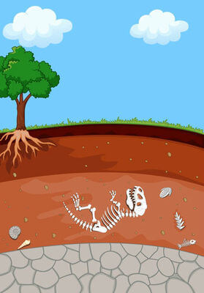
As soon as an organism dies, it no longer takes in carbon from food or the atmosphere to replace the carbon-14 that has decayed.
All of the carbon-14 present in a dead or fossilised organism should be carbon-14 that was present at its time of death.

Slide 26
Carbon-14 decays at a known rate; it has a half-life of 5730 years.
The ratio of carbon-12 to carbon-14 will change over time after the organism dies as the carbon-14 decays into nitrogen-14.
Measuring this ratio is what allows scientists to calculate the age of the organism or fossil.

Slide 27

When scientists want to calculate the age of a fossil or artefact, they can measure the amount of carbon-14 in the sample.
There are two main methods to do this:
1. | Beta counting detects the number of beta particles emitted from the sample from the radioactive decay of carbon-14 atoms.
2. | Accelerator mass spectrometry (AMS) directly counts the number of carbon-14 and carbon-12 atoms present in a sample.

Slide 28
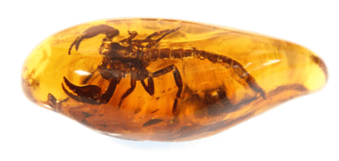
The scientists must then make certain assumptions in order to calculate the approximate age of the sample.
The two main assumptions they need to make are:
1. The decay rate of carbon-14 into nitrogen-14 is always constant.
2. The atmospheric levels of carbon-14 were the same in the past as they are today.
If these two assumptions are correct, then measuring the ratio of carbon-14 to carbon-12 allows them to accurately calculate how long it has been since the sample was living.

Slide 29
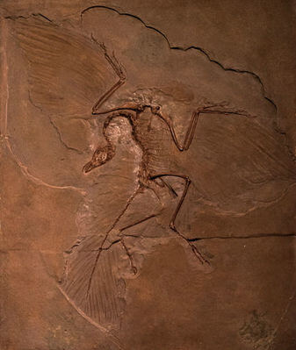
Carbon dating can only be used on samples up to about 60,000 years old, because after this time the amount of carbon-14 in a sample falls so low that it can no longer be detected.
This means that carbon dating is mainly used by archaeologists rather than paleontologists.
For older things like rock samples, isotopes with longer half-lives, such as uranium or potassium, are used.

Slide 30
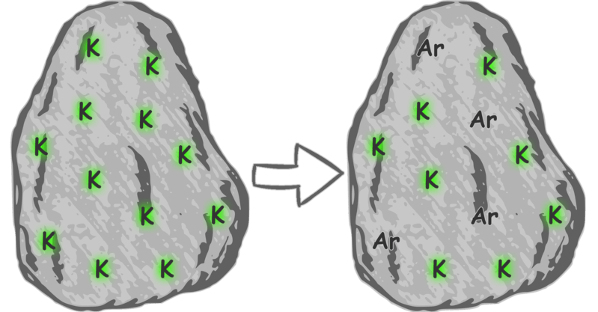
Potassium-Argon Dating
When dating samples which are hundreds of thousands of years old techniques such as carbon dating do not work, as they decay too quickly. Instead radioactive decay of materials that have much longer half-lives is needed.
One such substance is ⁴⁰K (Potassium-40). This radioactive form of potassium decays to form argon. The half-life is over a billion years, so is useful for dating materials which are over 100,000 years old. Potassium is a common component in many rock materials such as clay and mica. By measuring the ratio of potassium: argon, the age of a rock can be found.

Slide 31
As with carbon-dating, there are several assumptions and limitations involved in potassium-argon dating:
It is assumed the potassium decays at a constant rate.
It is assumed that all the argon produced is trapped within the rock.
As the measurement techniques are destructive, it is assumed the samples tested are representative of the rock as a whole.
There are limitations on accuracy of the measurements.
There is the risk of contamination of samples from other sources, such as argon in the air.
The technique has been used for dating old rocks, such as the Olduvai Gorge in Tanzania, Africa. Here key fossils have been found which help explain human evolution, so dating of the valley rocks has been of great importance.

